Slide 1


GenAI Security Assessments:
ChatGPT & Claude

Slide 2
WHY THIS MATTERS NOW
AI adoption is accelerating faster than governance and security.
Most firms are already integrated AI into their workflows.
These new assessments help clients answer:
“Are we using AI safely, defensibly, and in a way that minimizes business risk?”

Slide 3
WHAT WE’RE LAUNCHING
REQUIREMENTS:
-An enterprise version of the AI tool being audited.
-An AI tool administrator who has access to all security configurations.
-Dedicated time to perform a screenshare with the client.
Two new, parallel offerings:
ChatGPT Security Assessment
Claude Security Assessment
Gemini is in progress but not available yet
Both are expert-led, point‑in‑time security and governance configuration reviews of how the organization is using the AI platform. These are meant to lead to:
Alignment with other Drawbridge services
Better visibility into the firm’s risk profile
Recurring audits
“This is a structured audit of AI security controls and governance—focused on preventing data leakage, misuse, and compliance gaps.”

Slide 4
WHO IS THIS IS FOR
Common trigger events
“We want to scale AI, but don’t know our risk exposure”
Employees using AI without clear rules (shadow AI)
Investor, board, or regulator questions about AI use
Security or compliance teams being asked to “sign off” on AI
Clients who are already using ChatGPT Enterprise or Claude Enterprise
Firms concerned with investor or regulatory requirements related to cybersecurity.
Organizations handling sensitive or confidential data.
Leadership asking for AI policies, guardrails, or oversight.

Slide 5
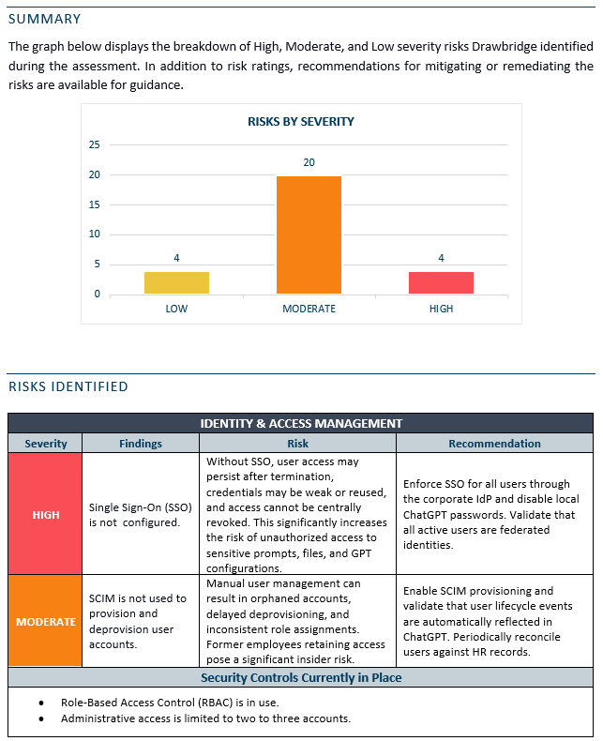
WHAT WE ACTUALLY DO
Discovery & current-state review
Identify how AI is being used across teams
Review access controls and authentication
Understand governance, policies, and training coverage
Platform-specific control audit
Identity & access management
Data protection and privacy
Sharing and collaboration settings
Integrations and connectors
Configuration hardening
AI feature and capability risks
Governance, training, and oversight
Risk findings & remediation roadmap
Clear, prioritized findings (high / moderate / low)
Practical remediation guidance
Quick wins vs longer-term improvements
Clear next steps (policy, training, TTX, etc.)

Slide 6
REAL-WORLD EXAMPLES
Clients are usually surprised by what settings are turned on by default.
AI access to sensitive data magnifies existing permission issues. This give employees to data they shouldn’t be accessing.
Teams are allowed to share prompts, GPTs, or sessions publicly without realizing it.
Developers or power users are enabling advanced AI features without training or guardrails.
Most incident response plans and tabletop exercises don’t account for AI misuse scenarios.

Slide 7
Positioning and Discovery
Core message:
“This helps you innovate with AI while staying aligned with security, investor, and regulatory requirements. AI usage significantly increases the firm’s attack surface, and these exercises aim to mitigate reputational and financial damage due to a weak AI security program”
This is:
A proactive AI security audit, not a reaction to an incident
A governance and compliance readiness exercise
A way to enable safe AI adoption, not slow it down
A fast, high‑value engagement that opens the door to more work

Slide 8
Scope guardrails
What’s included
Audit of controls and processes via screenshare/interview
Risk findings and a remediation recommendations report
Ongoing risk mitigation guidance from our advisors.
What’s not included
Implementing controls
Acting as platform admins
Continuous monitoring
AI pentesting or prompt injection testing (yet)

Slide 9
Services Alignment
Natural next steps (or steps to take in parallel with these assessments):
AI security awareness training
Vendor Risk Assessment
AI policy development (dedicated AI policies are on the way)
AI-focused tabletop exercises
Phishing Campaigns
CRA and Cloud Assessments

